Slide 1
JEDI-07 GROUP 8

Slide 2
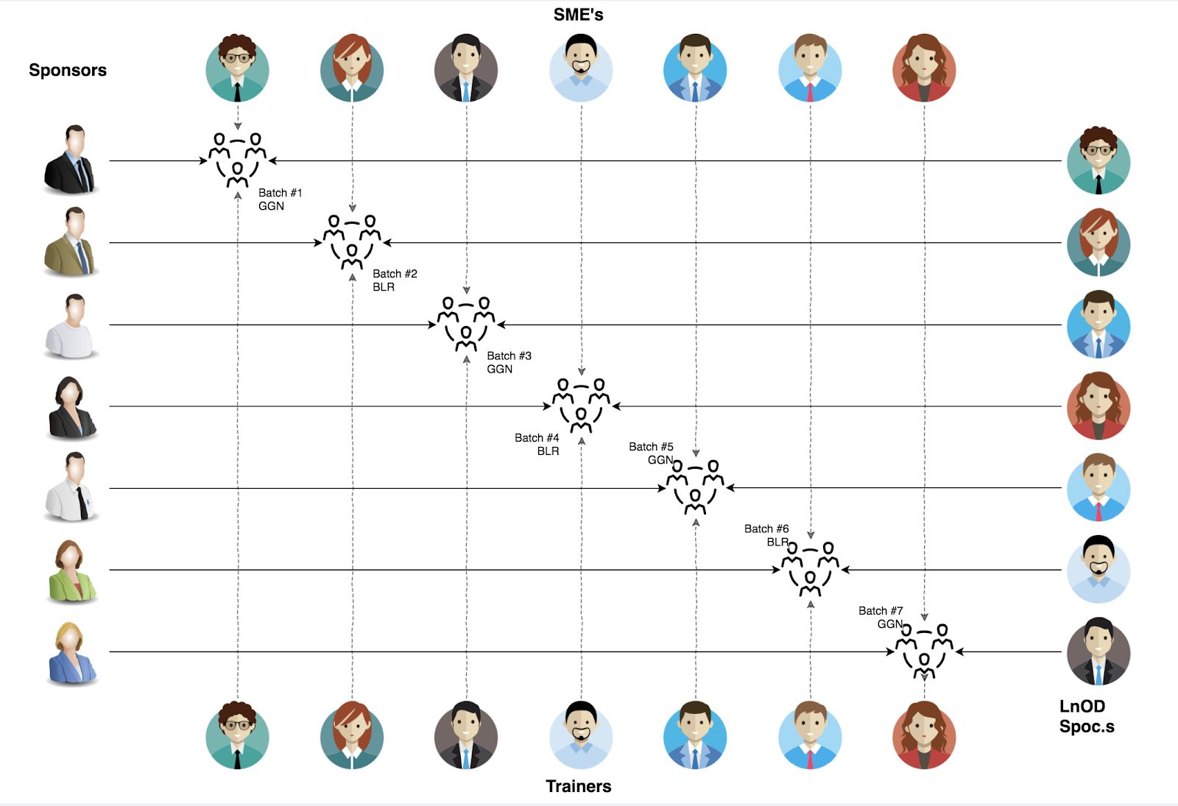
Stakeholders
Sponsors
Flipkart
SME’s
Amit Balyan
Coordinators
Deepika Gajaraj

Slide 3

Framework for 3 Weeks
 | Modules | Description
Week 1 | UNIX GIT Use Case & UML Diagrams | Understanding Unix and Git commands Requirement understanding & diagram design
Week 2 | Java 8 Exception Handling SQL | Developing a POS application using Java & MySQL Understanding Java 8 features and collections
Week 3 | Jersey & DropWizard | REST API development using Jersey and Drop Wizard framework

Slide 4
OUR NEXT STARTS NOW

Slide 5

AGENDA
OUR JOURNEY
OUR TEAM
PROJECT GOALS
ENGINEERING PRACTICES
TECH STACK
UML DESIGN
ARCHITECTURAL DESIGN
DEVELOPMENT
DEMO
CHALLENGES AND LEARNING
QUESTIONS

Slide 6
2 WEEKS OF TRAINING + PROJECT DEMO
13 DAYS
104 HOURS
6,240 MINUTES
3,74,400 SECONDS
LIMITLESS KNOWLEDGE

Slide 7
OUR JOURNEY
Understanding Project Goals
Creating Terminal based POS Application
Conversion to DropWizard Application
1
3
5
2
4
Design UML Diagrams
Adding REST functionality using JERSEY

Slide 8
OUR TEAM

Slide 9
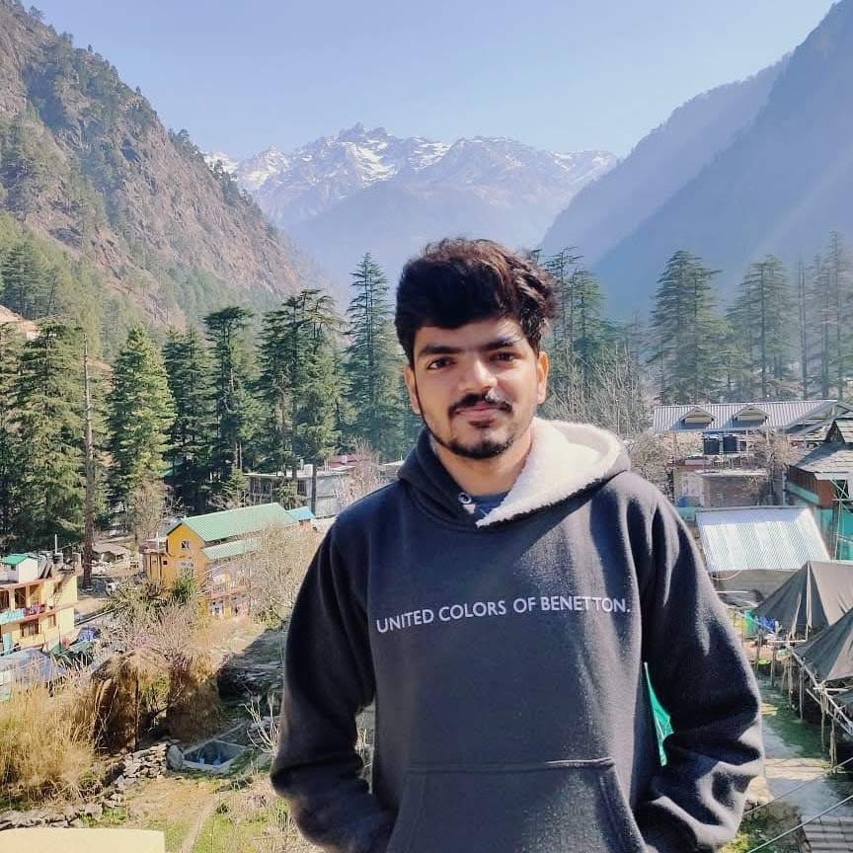
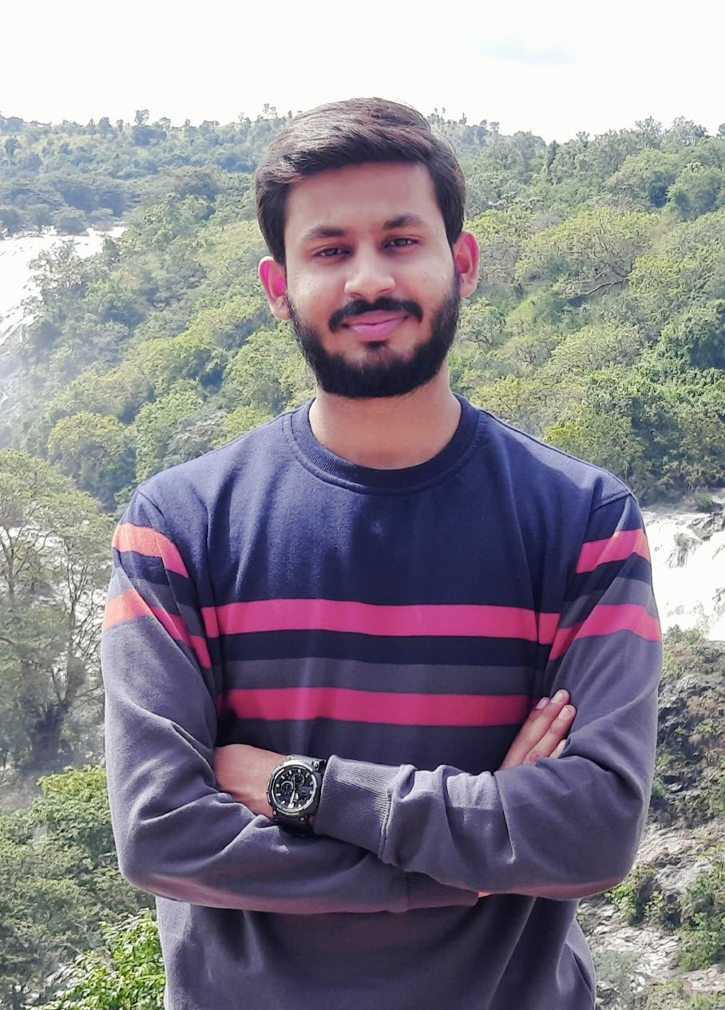
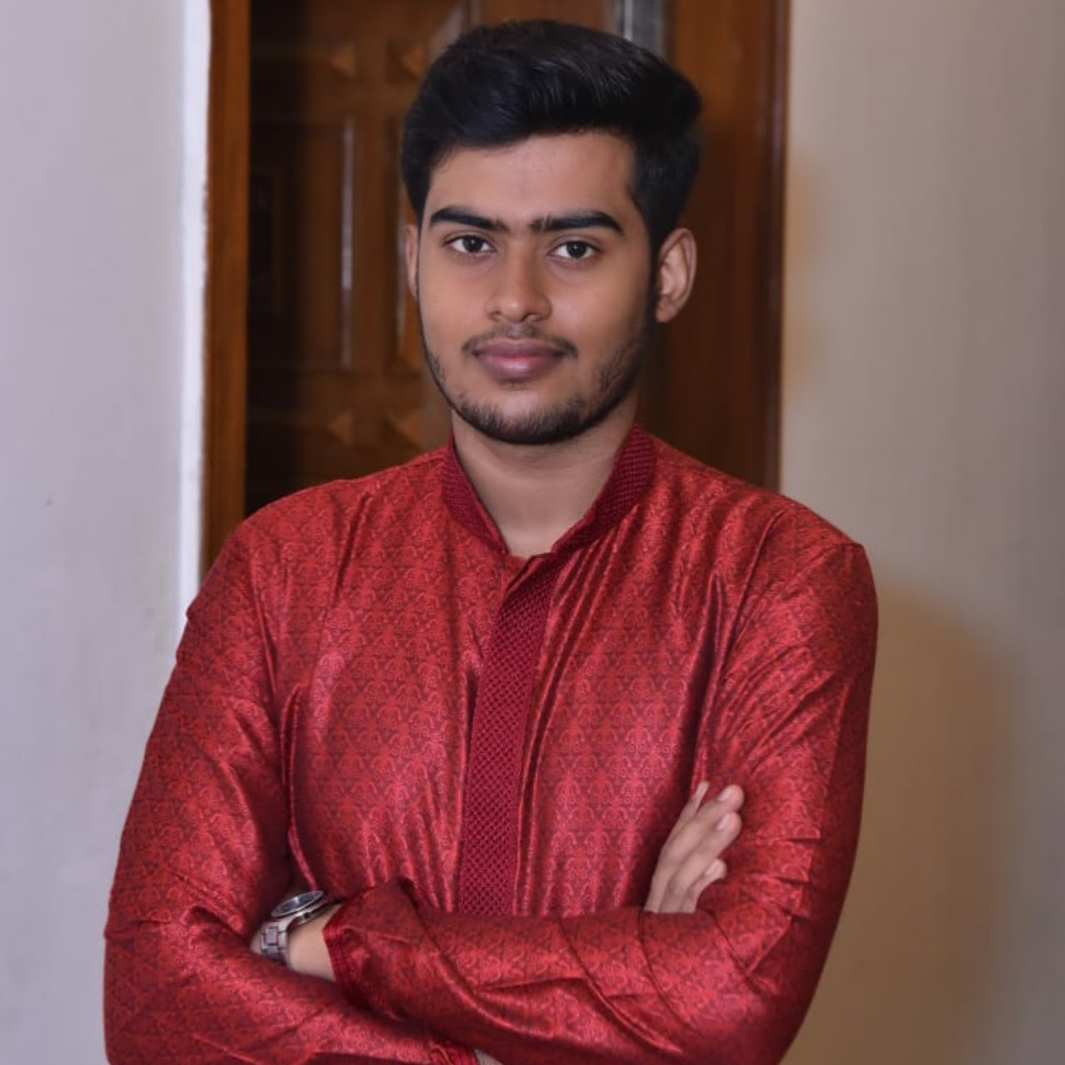
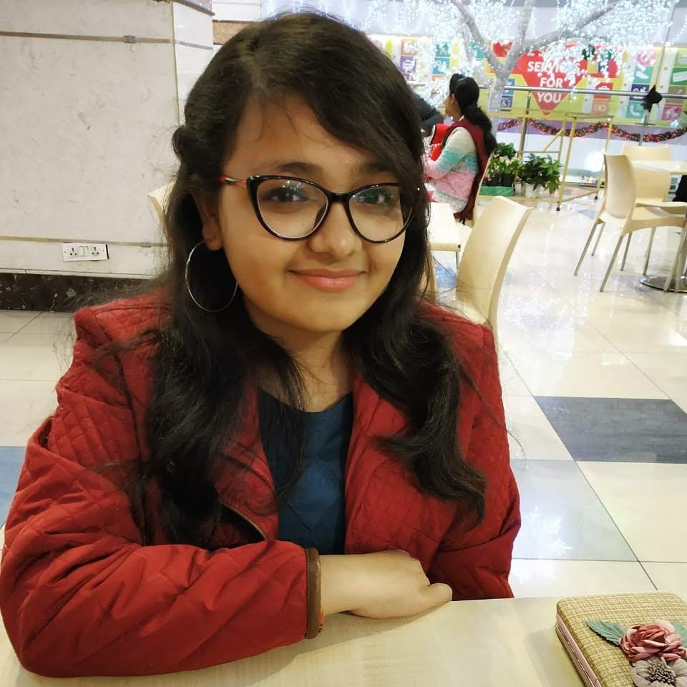



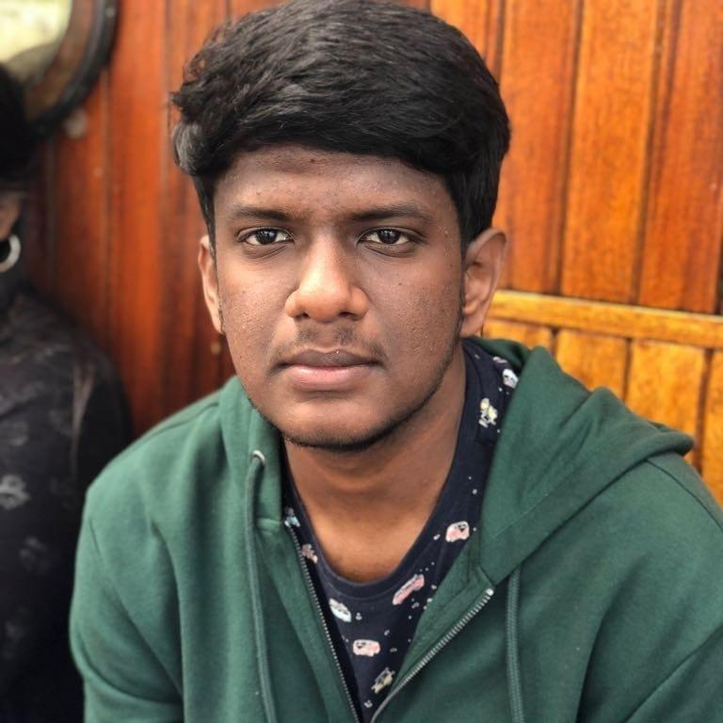
Kumar Ujjwaldisha Batra(GL)
Vinayak Chaturvedi
Tushar Amrit
Shipra Gaur
Adarsh Abhijat
Pavan Kotak
Sajith K
Aryan Gaurav

Slide 10
Team Member | Responsibility
Kumar Ujjwaldisha Batra | Admin module implementation in POS, Student module in Jersey and Dropwizard. Worked on integration exception for student module.
Vinayak Chaturvedi | Professor module implementation in POS, Jersey and Dropwizard, Loggers and Exception handling.
Tushar Amrit | UML Designing, Implementation of POS Application Package, Implementation of Exception Classes
Shipra Gaur | UML Designing , Implementation of Dropwizard Application, Testing the Application , SQL queries
Adarsh Abhijat | Made Interfaces for DAO and Business classes, method level comments, implemented Admin in Jersey and Validators for Student,Admin,Professor .
Pavan Kotak | UML Designing, Implementation of various functionalities in the DAO and Business Classes
Sajith K | UML Designing, Creating Documentation and Testing the application
Aryan Gaurav | UML Designing, Activity Diagram, Testing the application and Documentation

Slide 11

PROJECT GOALS

Slide 12




Problem Statement
To develop a POS application and REST API for Course Registration System using JAVA where :
student can register, add/drop course,
professors can view courses, enrolled students,
admin can manage users, add/drop courses to catalog.
1
2
3
4
Quality
Security
Interactivity
Speed

Slide 13
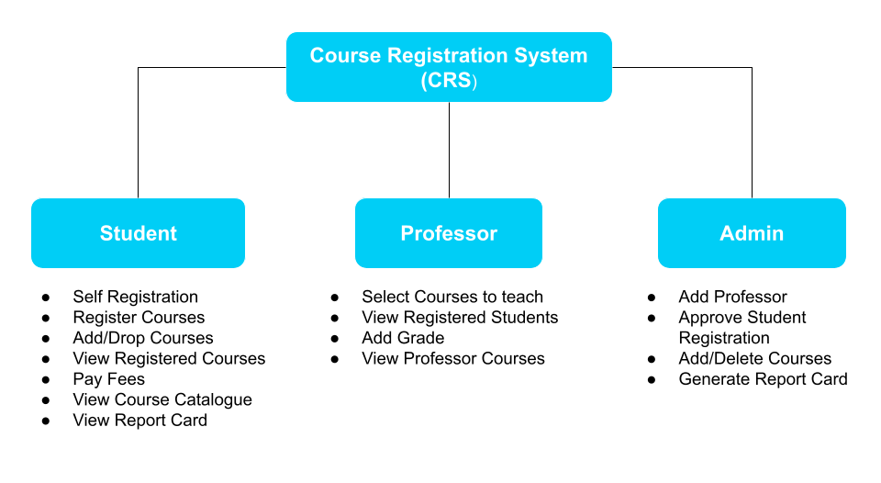

Slide 14

ENGINEERING PRACTICES

Slide 15
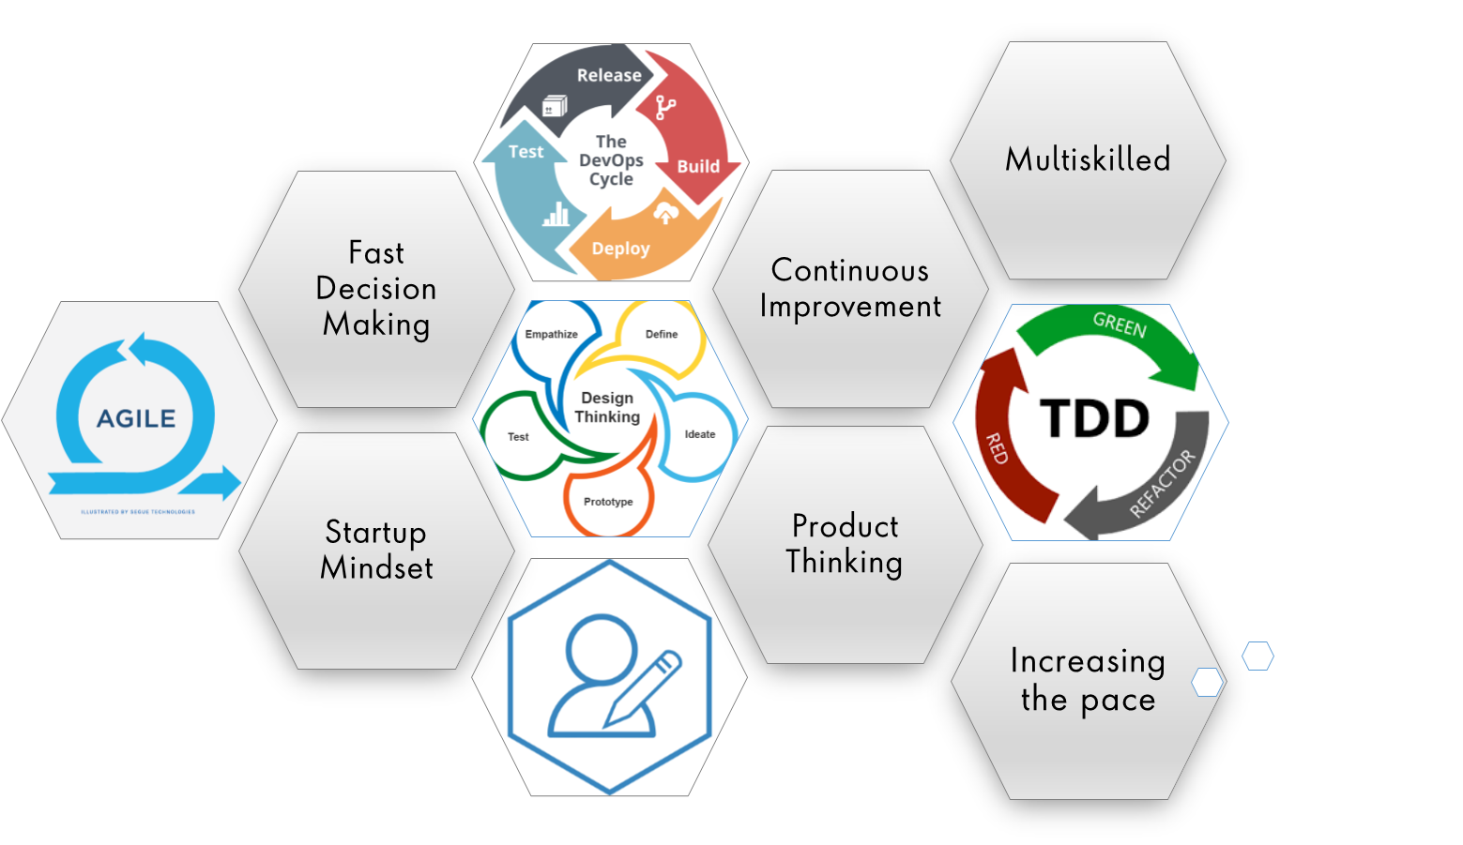
Agile Methodology

Slide 16
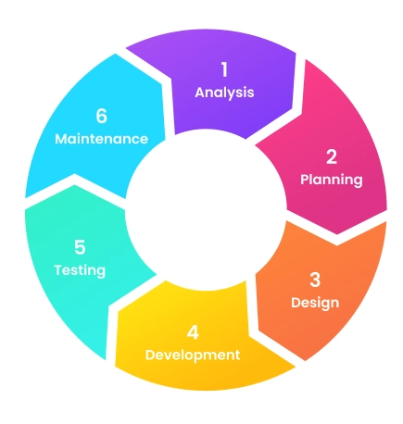
6 Stages of Software Development Process

Slide 17

TECH STACK

Slide 18
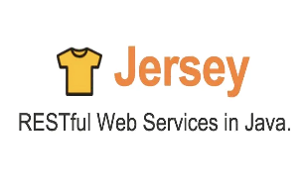







Tech Stack
Core Language
SQL Database
Version Control
Application Server
API Client
Diagramming Application

Slide 19
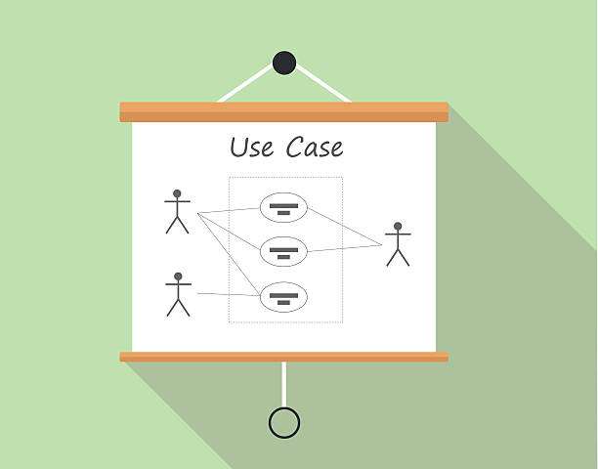
UML DESIGN

Slide 20
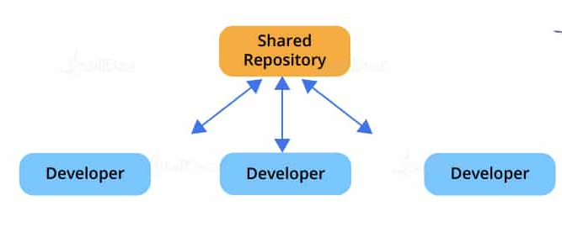
Version Control

Slide 21
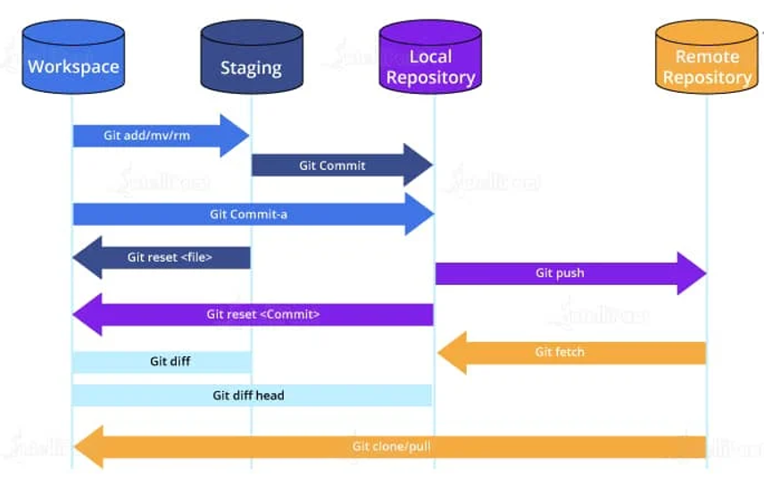
GIT Workflow

Slide 22

ARCHITECTURAL DESIGN

Slide 23
CRS Application
JAVA POS APPLICATION
DROPWIZARD APPLICATION
JERSEY API

Slide 24
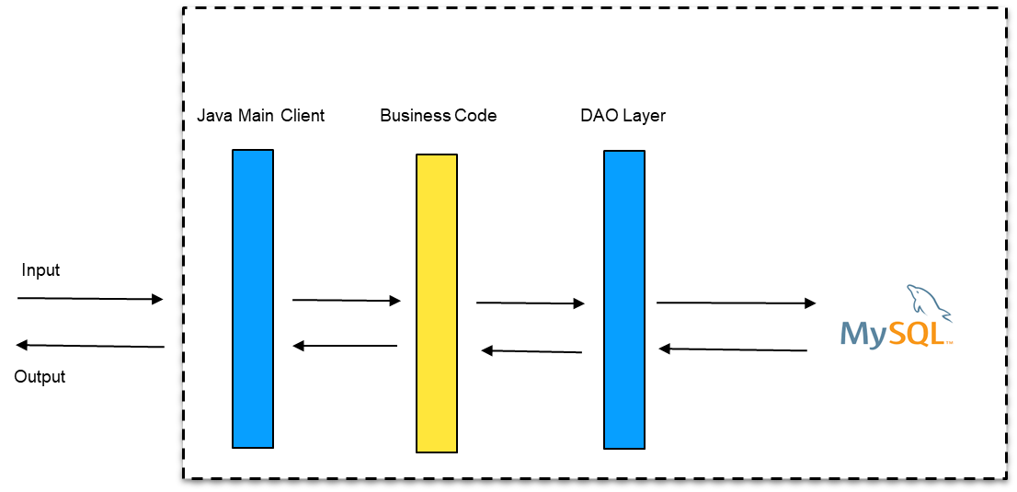

System Architecture: POS Application

Slide 25
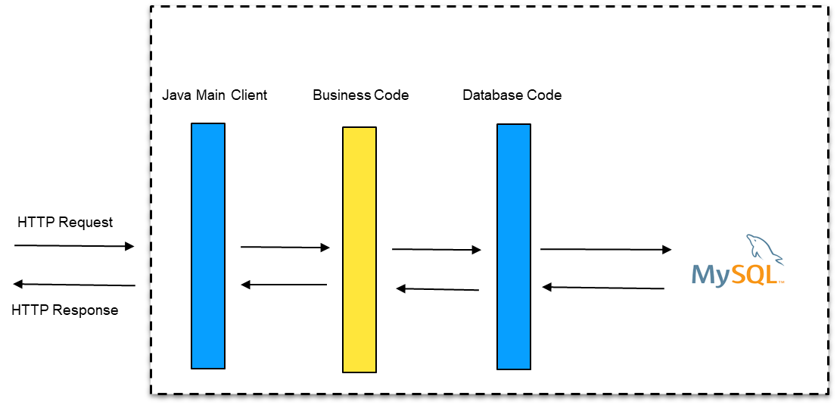


System Architecture: REST API

Slide 26

DEMO

Slide 27
Learnings
New technologies. - Jersey, Tomcat, Maven, Postman,etc.
Team Work (collaboration)
LifeCycle of a project
Industry level project experience
Learnt how to make UML diagrams for the given problem.
Learnt to configure Maven and DropWizard.
Integration of REST Services with JAVA code using Tomcat and Jersey
Version control using GIT - merging, PRs,etc.

Slide 28
Challenges
Database Integration Challenges
Resolving merge conflicts in Git
Installing the Tomcat server and running application on it
Resolving jar & version dependencies

Slide 29

ANY
QUESTIONS?

Slide 30
THANK YOU

